Slide 1
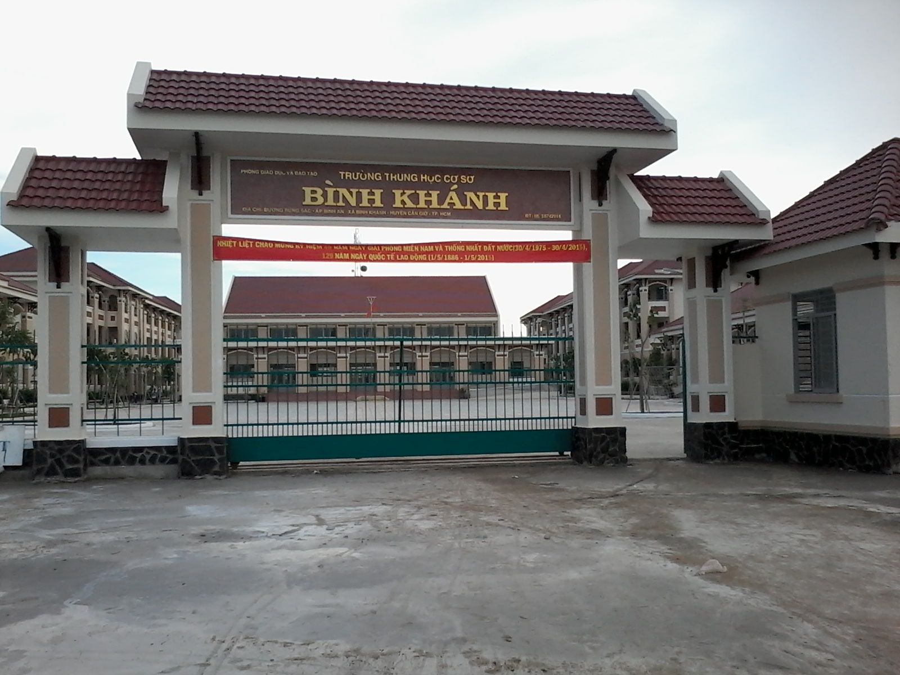



BINH KHANH SECONDARY SCHOOL
FRIENDS PLUS 6

Slide 2
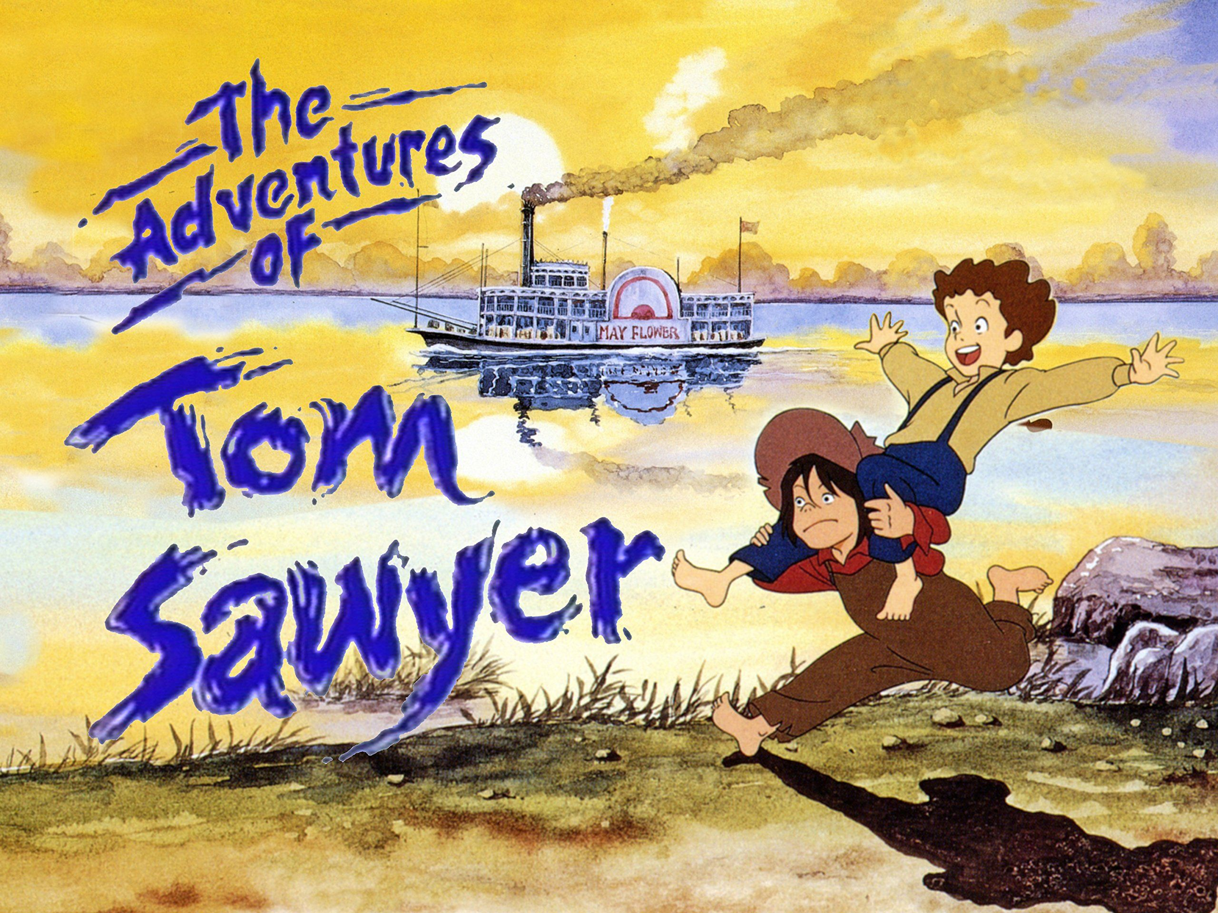
UNIT 7: CLIL - LANGUAGE AND LITERATURE

Slide 3
* MATCHING:
WORDS | DEFINITIONS
1/ a pipe | a/ to leave a place or a person
2/ to sleep out | b/ there is little or no light.
3/ the dark | c/ a narrow tube with a bowl at one end, used for smoking
4/ to run away | d/ to sleep in the open air
1 - c
2 - d
3 - b
4 - a

Slide 4
1/ Complete the sentences by using the given words in the box:
pipe, sleep out, the dark, run away
1/ We got up when it was 3 a.m., so we left the campsite in ______ .
2/ We wanted to ________ because there were a lot of insects near the river.
3/ Smoking a ________ is bad for your health.
4/ If you __________ in summer, you can look at the stars in the night sky.
the dark
run away
pipe
sleep out

Slide 5
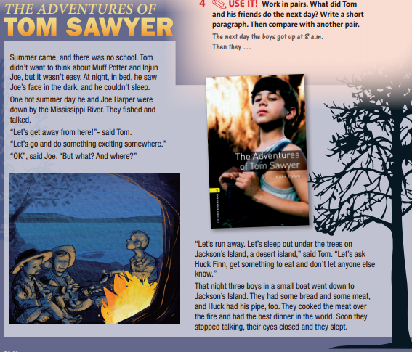
2/ Read the text. Then answer the questions:
1
2
3
4, 5

Slide 6
2/ Read the text. Then answer the questions:
1/ Why couldn’t Tom sleep?
-> He was scared. / He saw Injun Joe’s face in the dark.
2/ Why did Tom want to go to Jackson’s island?
-> He wanted to get away / do something exciting.
3/ How many boys went to the island?
-> Three (Tom, Joe, Huck).
4/ Where did they make a fire?
-> On Jackson’s Island.
5/ What did they think of their dinner?
-> They thought it was very good. / The best dinner in the world.

Slide 7

3/ read and listen to the text. Find a person or place for
sentences 1-4:
Muff Potter/ Injun Joe
1/ Someone Tom didn’t like ___________________.
2/ A place with boats _______________.
3/ The place where the boys went to sleep out ________________.
4/ Tom and Joe’s friend _____________.
Mississippi River
Jackson’s Island
Huck Finn

Slide 8
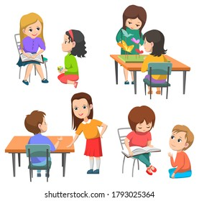
4/ USE IT! Work in pairs. What did Tom and his friends do the next day? Write a short paragraph. Then compare with another pair.
*For example:
- The next day the boys
got up at 8 a.m.
- Then they …

Slide 9

* SPEAKING:
intelligent, brave, adventurous, honest
1/ Work in groups and use these adjectives to describe Tom Sawyers.
*For example:
- He’s intelligent because he thinks about getting food before they go to the island.

Slide 10
* SPEAKING:
2/ Which teenage characters they admire and why. Ask groups to tell the class about a character they admire.

Slide 11

* Homework: - Learn by heart all the new words. - Prepare for the next lesson – Unit 7: Puzzles and games.

